Slide 1
Actionscript 3.0 Basics
4 – Animation

Slide 2


Animation Techniques
Using Authoring Tool
Programmatic Techniques:
  Using flash rendering engine:
    Using ENTER_FRAME event
    Using Timer
  Anternative Rendering:
    Blitting
    Stage3D (future)

Slide 3
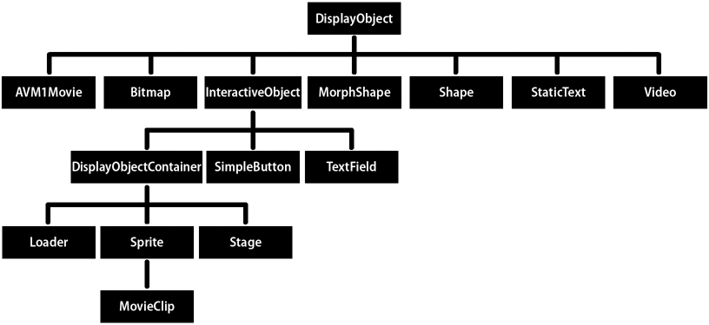

MovieClip

Slide 4
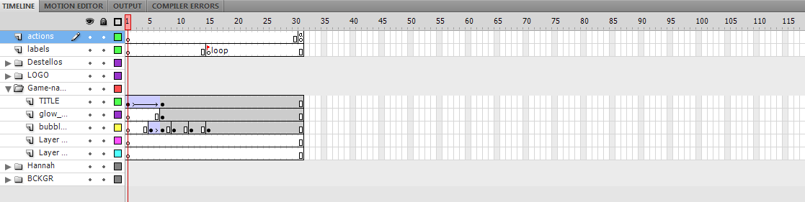
Timeline
Animation as smooth transitions between states.

Slide 5
Pros & Cons
Using Authoring Tool
Easier, very familiar for designers and animatiors.
No need for programming knowledge.
Animations are atomic.
Hard to add dynamism.
Not easiliy accesible from code.

Slide 6
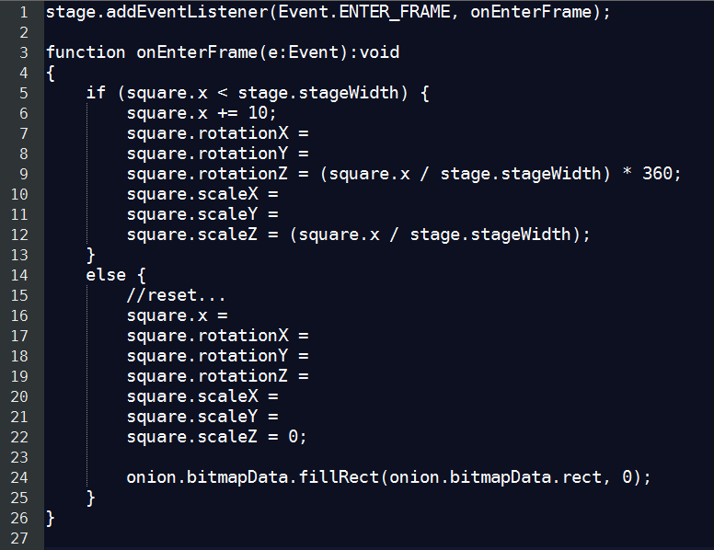
Programmatic Animation
Write code that performs timely syncronized changes to a display object properties.

Slide 7
Pros & Cons
Programmatic Animation
Animations are totally dynamic.
Animations can change according conditions.
You have to describe as code the entire animation.
Requires Programming skills.

Slide 8

Blitting
Spritesheet
Programatically perform in-place frame replacement.

Slide 9
Pros & Cons
Blitting
Blazing Fast.
Allows more complex graphics for animation.
Animations are atomic.
Hard to add dynamism.
Requires some extra work.

Slide 10

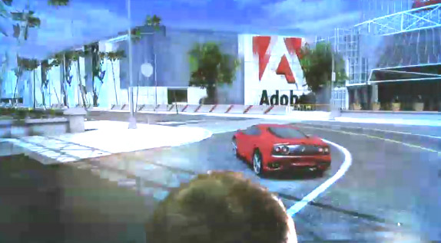
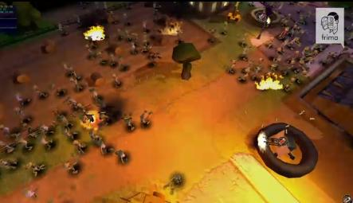
Stage3D
Completely new 3D rendering engine.
Uses hardware acceleration.
Complex Apis, requires 3D programmatic Animation Skills.
Authoring tools will be available.

Slide 11
Thanks!
github.com/matix/as3basics
matias.figueroa@globant.com
@matixfigueroa

